Slide 1
The technique for investigating the background of scientific questions
Enwei Zhao
Notes:
Hello everyone, today I would like to share some of my personal thoughts about the technique for investigating the background for scientific questions.

Slide 2
1. Introduction

Slide 3
Definition
The technique for investigating the background of scientific questions：: the technique for systematically searching and integrating information relevant to a scientific question in order to accurately depict its background.
Scientific questions：something that usually exist in the form of interrogative sentences which points to the falsifiable unknown based on the falsifiable known; Scientific questions are usually solved in a reproducible and open way; whose purpose is to understand the world and/or changing the world.
Background：the unity of the information relevant to a certain entity at a given moment.
The techniques for investigating：the combination of systematic algorithms and concrete tools which aim to search and integrate information.
Notes:
First thing first, the definition for this technique is: the technique for systematically searching and integrating information relevant to a scientific question in order to accurately depict its background.
More specifically, scientific questions refer to something that usually exist in the form of interrogative sentences which points to the falsifiable unknown based on the falsifiable known; Scientific questions are usually solved in a reproducible and open way; whose purpose is to understand the world and, or change the world.
And the background refers to the unity of the information relevant to a certain entity at a given moment.
The technique for investigating refers to the combination of systematic algorithms and concrete tools which aim to search and integrate information.

Slide 4
Significances and overall workflow
Significances: (1)Helping find the right scientific questions efficiently and giving the questions accurate definitions；
(2)Helping answer the question
Depict the background structure for the question
General background investigation
Academic background investigation
Notes:
The significances of this technique are; first this technique can help find the right scientific questions efficiently and give the questions accurate definitions.
Second, it can help answer the question.
Overall, the workflow for this technique includes three steps: first, depict the background structure for the question; then comes the general background investigation, then the academic background investigation.
In the following sections, I would elaborate on each of them.

Slide 5
2. Depict the background structure for the question

Slide 6
Definition, meaning and workflow
Depict the background structure for the question：Based on the key concepts in the question and their combinations to create the knowledge network behind the question.
Significance：Structuring and visualizing the background of the question and providing visual aids for the following investigations.
Use an interrogative sentence to represent the major components of your research
Decide the key concepts and formulate your definitions for them
Combine these concepts exhaustively
Notes:
The definition of depicting the background structure of a question is: Based on the key concepts in the question and their combinations to create the knowledge network behind the question.
The significance of this step is: Structuring and visualizing the background of the question and providing visual aids for the following investigations.
This step’s workflow includes: first, use an interrogative sentence to represent the major components of your research, then decide the key concepts and formulate your definitions for them, lastly, combine these concepts exhaustively.

Slide 7
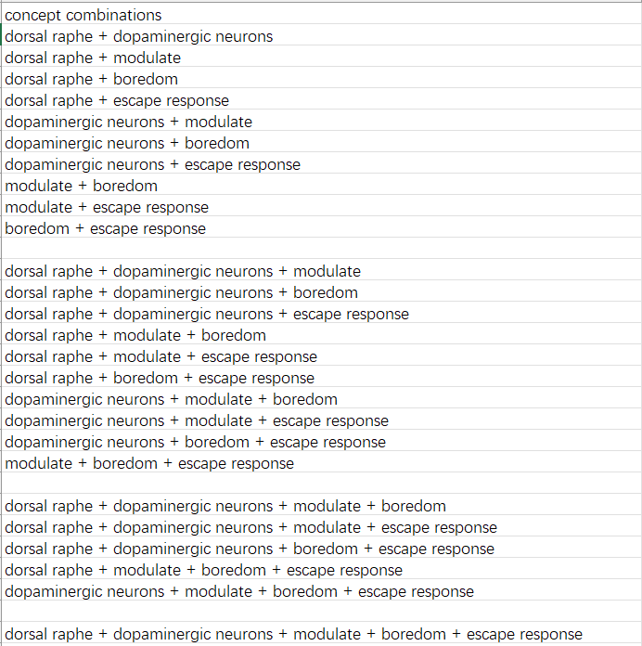
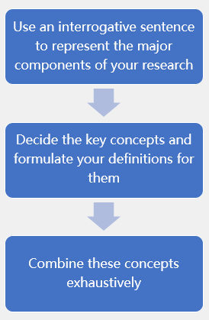
Depict the background structure for a question
How do the dorsal raphe dopaminergic neurons modulate the escape response to boredom?
Key concepts | Definitions
Dorsal raphe nucleus | a nucleus in the brain stem, which mainly consists of serotoninergic neurons. But recently a relatively small number of dopaminergic neurons have also been found here.
Dopaminergic neurons | to neurons which can synthesize and release dopamine. Modulate means influencing in a slow, broad way.
Modulate | influencing in a slow, broad way.
Boredom | the psychological state of being in need of novel stimuli
Escape response | to the behavior which aims to increase the physical and/or psychological distance between the individuals and aversive stimuli.
Notes:
Now I will use a question which I recently find interesting as an example to explain this workflow. The question is: How do the dorsal raphe dopaminergic neurons modulate the escape response to boredom?
I think there are five key concepts in this question. Their definitions are as presented in the table. Dorsal raphe nucleus refers to a nucleus in the brain stem, which mainly consists of serotoninergic neurons. But recently a relatively small number of dopaminergic neurons have also been found here.
Dopaminergic neurons refer to neurons which can synthesize and release dopamine.
Modulate means influencing in a slow, broad way.
Boredom refers to the psychological state of being in need of novel stimuli.
Escape response refers to the behavior which aims to increase the physical and, or psychological distance between the individuals and aversive stimuli.
The results of the exhaustive combination for these concepts are as shown in the picture. These concept combinations along with the five key concepts constitute the background structure of the current question.

Slide 8
3. General background investigation
Notes:
And then we move to the second step, general background investigation.

Slide 9
Definition and significance
General background investigation：Driven by the need to ask questions about a specific concept combination, explore freely about that concept or concept combination regardless of the information sources.
Significance：developing a clear understanding of key concepts and their combinations, refining the question's definition, exploring diverse implications, and solving it flexibly.
Notes:
Its definition is: Driven by the need to ask questions about a specific concept combination, explore freely about that concept or concept combination regardless of the information sources.
This step is crucial for developing a clear understanding of key concepts and their combinations, refining the question's definition, exploring diverse implications, and solving it flexibly.

Slide 10
Workflow
no
Try to ask a relatively interesting and non-repetitive question which includes all the elements in a certain concept combination.
Understanding insufficient to ask a question?
Sufficient understanding of all key concepts and their combinations?
no
Ask the question
yes
yes
Explore that concept or concept combination freely.
End investigation
Notes:
The following is this step’s workflow: First, try to ask a relatively interesting and non-repetitive question which include all the elements in a certain concept combination. During this process, you should actively measure your own grasp of the key concepts and their combinations.
If you find your understanding of a certain concept or concept combination is not good enough and thus can’t ask an appropriate question for the time being.
then, you should explore that concept or concept combination freely
until you can ask an appropriate question
When feeling confident enough about your own grasp of all the concepts and their combinations, you may terminate this stage of investigation.
Otherwise, you should loop the above steps.

Slide 11
Free exploration
Definition：Any behavior you find interesting and feasible, which can facilitate your understanding of the target concept or concept combination.
Recommended tools | Features
Wikipedia | diverse perspectives ；abundant hyperlink
perplexity（https://www.perplexity.ai/） | accurate；fast
Notes:
Here free exploration needs more explanation. This refers to any behavior you find interesting and feasible, which can facilitate your understanding of the target concept or concept combination. Apart from reading academic papers, free exploration may also be reading relevant news, novels, watching relevant movies, chatting with other people about relevant topics, or even visiting a relevant place.
I recommend two tools for free exploration: the first is Wikipedia. It has two major features, that is, diverse perspectives and abundant hyperlinks. Wikipedia is made by people from across the globe, all walks of life, with different ages and genders. These different groups of people’s different biases contribute to a broad range of perspectives which are especially beneficial for free exploration. Additionally, each Wikipedia page features numerous hyperlinks to other pages, creating countless paths for further exploration.
The second tool is Perplexity, which is a novel searching tool based on large language model technology and has been specially fine tuned for searching. It’s both accurate and fast. Perplexity would attach the information sources for each answer it produces, which makes it easier for us to verify its responses. And it’s fast because it can generate a coherent and well formatted review article in just few seconds.

Slide 12
General background investigation: an example
Try to ask a relatively interesting and non-repetitive question which includes all the elements in a certain concept combination.
modulate + boredom + escape response
Understanding insufficient to ask a question?
insufficient understanding of “modulate”
yes
explored “modulate” and learned that dopamine can serve as both neuromodulators and neurotransmitters.
Explore that concept or concept combination freely.
In the escape response to boredom, does dopamine act more as neurotransmitters or neuromodulators?
Ask the question
Notes:
And likewise, I would also use an example to illustrate the workflow of general background investigation. Say, I was trying to ask a question for the combination “modulate + boredom + escape response”
But during the attempt, I realized I didn’t really understand “modulate”
So, I decided to explore “modulate” and learned that dopamine can serve as both neuromodulators which have global, slow effects and neurotransmitters which have regional, fast effects.
Then I thought I could ask a question about this combination, that is: In the escape response to boredom, does dopamine act more as neurotransmitters or neuromodulators?
And so far, we’ve covered the major procedures for general background investigation.

Slide 13
4.Academic background investigation
Notes:
The next is the most critical step, academic background investigation

Slide 14
Definition and significance
Academic specific background investigation：Guided by a question’s background structure, carrying out systematic investigations within academic literature.
Academic literature：Literature that have references, or have both references and citing literature. This includes mainly peer-reviewed journal and conference articles but also includes dissertations, preprints and monographs.
Significances：(1) Accurately defining the research question within the scope of existing academic knowledge
(2) Establishing clear theoretical and/or applicational significance for the question
(3) Leveraging academic knowledge to identify the best tools for answering the question.
Notes:
The definition of this step is: Guided by a question’s background structure, carrying out systematic investigations within academic literature.
And the definition of academic literature is: Literature that have references, or have both references and citing literature. This includes mainly peer-reviewed journal and conference articles but also includes dissertations, preprints and monographs.
The significances of this step are: first this can accurately define the research question within the scope of existing academic knowledge
Second, this can establish clear theoretical and, or practical significance for the question.
Third, academic specific investigation can leverage academic knowledge to identify the best tools for answering the question.

Slide 15
Workflow
Decide which combination to investigate
AI search
Design the preliminary query and search
Explore for relevant articles
Formulate a more mature query and search again
Citation chasing
Read and summarize
yes
Appropriate to investigate more?
no
End the investigation
Notes:
Next, I will introduce the workflow: first, you need to decide which combination to investigate.
Then comes the fast AI search.
Then based on the results of AI search and personal knowledge, design the preliminary query and search;
Now, based on the seed articles found through previous two steps and explore for relevant articles.
The next step is to formulate a more mature query based on the understanding improved by previous investigation and then search again.
After that, select appropriate articles as the starting points for citation network-based investigation in order to find the newest relevant articles.
Then read these latest articles and summarize what has been found through the investigation.
If it’s still appropriate to carry out specific investigation for other combinations, then loop the above steps.
Otherwise, you may terminate the academic background investigation.
And now we’ve covered the overall process of academic background investigation, next I would elaborate on some of the steps.

Slide 16
AI Search
Definition：: With the help of llm (Large language model)technology, using natural language to explore relevant literature in the academic database and get coherent literature review immediately.
Features：(1)Fast
(2) AI may make mistakes
(3) Researchers are relatively passive during the process
Recommended tools | Features
Undermind (https://undermind.ai/home/) | relatively more accurate；the cost is also relatively high
Perplexity (https://www.perplexity.ai/) Consensus(https://consensus.app/search/), scispace(https://typeset.io/), elicit(https://elicit.com/) | relatively less accurate and less cost
Notes:
Let’s begin with AI search, its definition is: With the help of llm (that is large language model) technology, using natural language to explore relevant literature in the academic database and get coherent literature review immediately.
AI search is first of all, fast, which mainly relies on natural language and doesn’t require specific knowledge to build a sophisticated query; And ai models also respond fast.
But even with fine-tuning for academic search, AI search tools can still make mistakes.
And during the searching process, it’s mainly AI that makes the decision for relevance, which is affected by the internal biases of models. Researchers are relatively passive in this process.
The following are several AI search tools that I find useful.
First, Undermind. This tool possibly has the highest accuracy among similar tools. But the cost of using is also relatively high. For one thing, the usability of the free version is quite limited; for another, depending on the complexity of the question, it usually takes approximately 3-5 minutes or even longer for Undermind to generate the results.
Other similar tools like Perplexity, consensus, scispace and elicit, though relatively less accurate compared with Undermind, their free versions usually have better use experience and respond much faster. Furthermore, because different tools rely on different searching algorithms, it would be helpful to compare different tools’ responses for the same question.

Slide 17
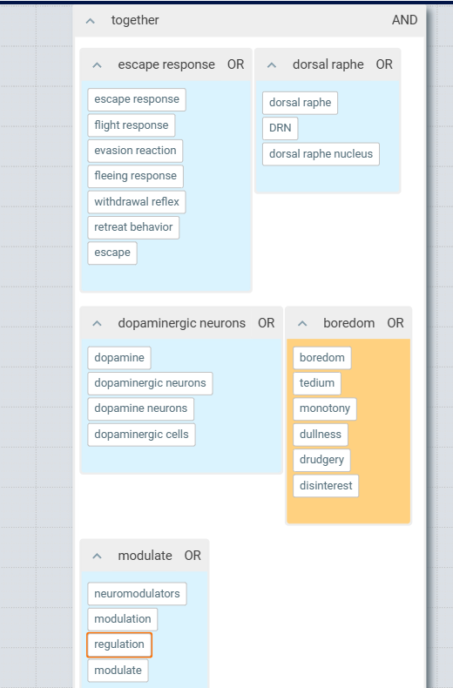
Query search
Recommended tool | Features
2d search（https://app.2dsearch.com/） | Visualized designing of query; query translation
Definition： searching academic literature database with Boolean query for highly relevant literature.
Features：（1）High accuracy
（2）Continuous refining
Recommended databases in biology and psychology | Features
Web of Science | Selective literature; supporting complex query and sophisticated screening conditions
Pubmed | Including abundant literature in biology and psychology; supporting complex query
Google Scholar | Huge size；limited support for complex query
Notes:
The next is query search, which means searching academic literature database with Boolean query for highly relevant literature.
The features of query search, first of all, is accurate. At the current stage, the accuracy achieved by a mature query, together with an appropriate search engine and database cannot been surpassed by AI search.
And in order to achieve the optimal accuracy, researchers need to iteratively refine their queries as their understanding of the research question improves.
I personally recommend using 2d search to help assist the design and use of the query. This tool has two key features. First, it can allow us to use graphical interface to design the query, which is way more efficient than manual design. Additionally, 2d search also provides query translations suitable for different databases, which can save us the trouble of memorizing syntax nuances among different databases.
Different fields usually require using different databases. For biology and psychology, I recommend the following databases. First, web of science. This database includes articles from influential academic journals. And it also supports complex query and sophisticated screening conditions. The next is Pubmed. It includes abundant literature from psychology and biology and supports complex queries. The last one is google scholar. It is probably the biggest academic database. But google scholar’s interpretation of complex queries is quite limited. It may miss some of the terms if the query is long and support query up to only 256 characters.

Slide 18
Explore relevant articles
Definition： Obtaining more relevant literature using search tools’ “related or similar articles” functionality.
Features：（1）Complementary results
（2）Facilitating refining of the query
（3）Helping researchers ask the right question
（4）Relatively more time-consuming
 | Recommended tools | Features
Single-seed based | Google Scholar’s “Related articles” function | Fairly good performance
 | Web of Science’s “relevant results” function | Relevance measurement is based on sharing references
 | Litmap(https://app.litmaps.co/) Connected Papers（https://www.connectedpapers.com/） | recommend relevant articles based on complex citation network algorithms.
Multi-seeds based | Litmap(https://app.litmaps.co/) | relatively high accuracy and cost
 | Research Rabbit(https://researchrabbitapp.com) | less accurate and free
Notes:
As for the exploration for relevant articles, it means obtaining more relevant articles using search tools’ “related or similar articles” functionality.
The results of this method are complementary to those from AI search and query search. Different seed articles together with all kinds of relevance algorithms may help find articles missed by the previous two methods.
And the knowledge acquired by the exploration process can be applied to refine the query.
Third, compared with the previous two methods, researchers participate more actively and frequently in the decisions for relevance in the exploration process. This can help researchers to measure their curiosity more deeply and thus researchers are more likely to ask the right question.
But this method usually takes longer.
The tools for exploring relevant articles can be divided into single-seed and multi-seeds based tools depending on whether the exploration is based on a single article or a group of articles sharing a similar theme. For single-seed based tools, I would recommend the following.
First, google scholar, although the exact algorithms remain unknown, the performance is fairly good and what’s most important is that the relevance exploration occurs in a huge database.
The relevant articles function of Web of science is based on the number of shared references between the seed article and other articles. Combined with Web of science’s sophisticated screening functionality, the results are usually quite good.
Litmap and connected papers recommend relevant articles based on complex citation network algorithms.
Because of the heterogeneity of the algorithms applied, the results from these tools are usually complementary.
When a sufficient number of similar articles have been obtained, say 20 of them, it’s generally a good idea to use this cluster of articles as input for multi-seed tool which can increase the efficiency of the exploration process. The first tool I recommend is litmap, whose performance should be the best among similar tools, but the usability of the free version is somewhat limited. The other tool I recommend is research rabbit, completely free but with worse performance compared with litmap.

Slide 19
Citation chasing
Two types of literature are suitable as the starting points：
（1） Classic articles with many citations.
（2） Articles which haven’t been cited heavily but are interesting.
Notes:
As for the step of chasing through the citation network to find the knowledge frontier, I think there are two categories of articles which are suitable as the starting points. The first is classic articles with many citations. The citation chasing based on this category aims to find reviews as new as possible.
The second category includes articles which haven’t been cited heavily but are interesting. Citation chasing based on this type of articles aims to find more recent similar works.

Slide 20
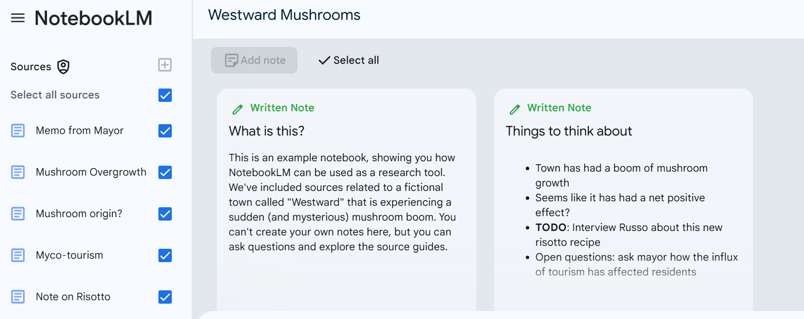
Read and summarize
Definition: read what you find interesting in the terminal articles selected by citation chasing and investigate their references when necessary; Document important articles and write a literature review based on them.
Recommended tools | Feature
Notebooklm (https://notebooklm.google.com/) | can carry out complex integration tasks across up to 50 custom sources.
Notes:
The definition of read and summarize is: read what you find interesting in the terminal articles selected by citation chasing and investigate their references when necessary; Document important articles and write a literature review based on them.
Here I would like to recommend a tool which can help with this task: Notebooklm, which is based on llm, and it can not only help interpret a single article but can also carry out complex integration tasks across up to 50 custom sources.

Slide 21
Whether or not to start another round of investigation
Basic principles：
(1):The investigation of the largest combination is necessary;
(2):Whenever possible, try to investigation as many combinations as possible;
(3):Larger combinations should be prioritized.
Notes:
As for whether or not to start investigation for another concept combination, this decision could depend on various specific details of different projects.
The basic principles are: The investigation of the largest combination is necessary;
whenever possible, try to investigate as many combinations as possible;
Larger combinations should be prioritized.

Slide 22
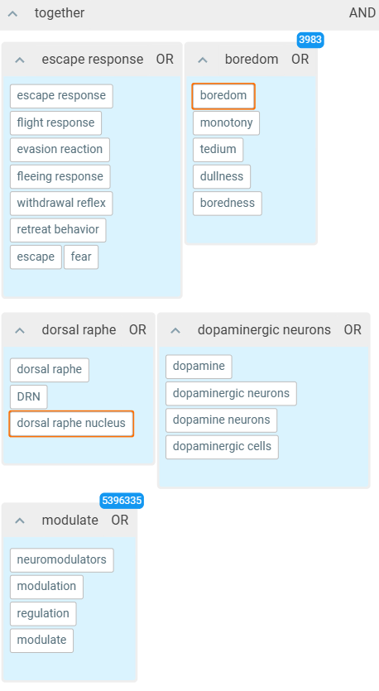
Academic background investigation: examples
Decide which combination to investigate
AI search
Query search
Relevant literature exploration
Citation chasing
Read and summarize
dorsal raphe + dopaminergic neurons + modulate + boredom + escape response
“I want to find experimental studies that focus on dorsal raphe dopaminergic neurons acting as neuromodulators in modulating the escape response specifically associated with boredom.”
0
0
not appliable
not applicable
literature review: So far no experimental studies has specifically focused on the dorsal raphe dopaminergic neurons’ modulating mechanism on animals’ escape responses to boredom.
Notes:
Now I would like to illustrate the workflow for academic background investigation using a few examples
I decided to first investigate the largest combination.
The sentence I used in AI search is: I want to find experimental studies that focus on dorsal raphe dopaminergic neurons acting as neuromodulators in modulating the escape response specifically associated with boredom.
But none of the tools I used has found highly relevant results.
Then I designed the query for this combination, as shown in the picture, and used this query to search many databases
No highly relevant results have been found.
As a result, the exploration for relevant articles and the citation chasing are not applicable.
Based on these investigation, here is the literature review: So far no experimental studies has specifically focused on the dorsal raphe dopaminergic neurons’ modulating mechanism on animals’ escape responses to boredom.

Slide 23
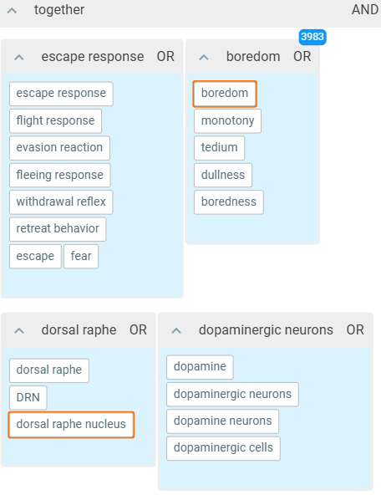
Academic background investigation: examples
Decide which combination to investigate
AI search
Query search
Relevant literature exploration
Citation chasing
Read and summarize
dorsal raphe + dopaminergic neurons + boredom + escape response
“I want to find experimental studies that provide mechanistic insights into dorsal raphe dopaminergic neurons acting as neuromodulators or neurotransmitters linked to the escape response associated with boredom, focusing on physiological data and neural circuitry mapping across different animal models.”
0
0
not appliable
not applicable
literature review: Likewise, neither are there studies focusing on dorsal raphe dopaminergic neurons’ effects on animals’ escape response to boredom when serving as neurotransmitters.
Notes:
The next combination I chose to investigate is this, which dropped “modulate”. This means I not only care about dopamine as neuromodulators but also as neurotransmitters.
The sentence I used in the AI search is: “I want to find experimental studies that provide mechanistic insights into dorsal raphe dopaminergic neurons acting as neuromodulators or neurotransmitters linked to the escape response associated with boredom, focusing on physiological data and neural circuitry mapping across different animal models.”
Again, no highly relevant results were returned.
I also dropped the module of “modulate” in the query as shown in the picture. But still no highly relevant results were found.
Similarly, the next two steps are not applicable.
Based on these results, the literature review was: Likewise, neither are there studies focusing on dorsal raphe dopaminergic neurons’ effects on animals’ escape response to boredom when serving as neurotransmitters.

Slide 24
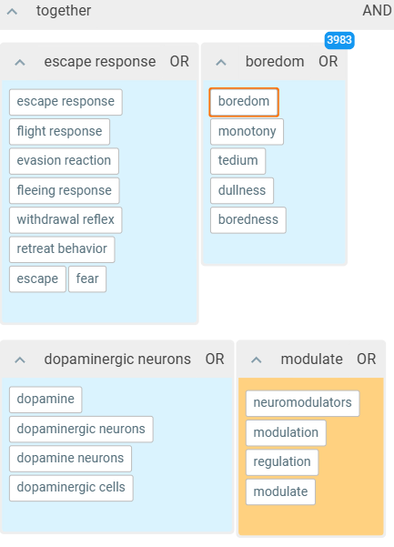
Academic background investigation: examples
Decide which combination to investigate
AI search
Query search
Relevant literature exploration
Citation chasing
Read and summarize
dopaminergic neurons + modulate + boredom + escape response
1(from undermind and scispace)
” I want to find experimental studies that explore how dopaminergic neurons act as neuromodulators in the escape response linked to boredom, focusing on physiological data and neural circuitry mapping across multiple animal models.”
0
0
not applicable
But there is one study which investigate how dopaminergic neurons in ventrolateral striatum modulated mice’ escape response to boredom(Yawata et al., 2022). In this study, mice in an empty cage would experience aversive air puff as something rewarding when compared with mice in an enriched cage. Dopamine levels in ventrolateral striatum increased before receiving air puffs actively, while decreasing after receiving air puffs.
Notes:
The next combination I chose is this, which dropped “dorsal raphe”. This means I care about dopaminergic neurons in all kinds of places.
The sentence I used in AI search is:” I want to find experimental studies that explore how dopaminergic neurons act as neuromodulators in the escape response linked to boredom, focusing on physiological data and neural circuitry mapping across multiple animal models.”
And this time, Undermind and scispace found the same highly relevant article.
But query search still didn’t found anything relevant enough.
Then, I tried to use this article to find more relevant articles. But because this article is a conference paper and no full-text is available online yet. So the references data were missing and no other studies had cited this article yet. As a result, tools based on citation network were not feasible. And tools based on semantics didn’t find anything very relevant.
And the citation chasing was also not applicable since the lack of citation.
Then based on the abstract of this highly relevant study, the literature review I formed was: But there is one study which investigate how dopaminergic neurons in ventrolateral striatum modulated mice’ escape response to boredom. In this study, mice in an empty cage would experience aversive air puff as something rewarding when compared with mice in an enriched cage. Dopamine levels in ventrolateral striatum increased before receiving air puffs actively, while decreasing after receiving air puffs.
The above is the introduction to the key steps of academic background investigation.

Slide 25
5.Summary
Notes:
In the end, I would briefly summarize what we’ve covered so far.

Slide 26
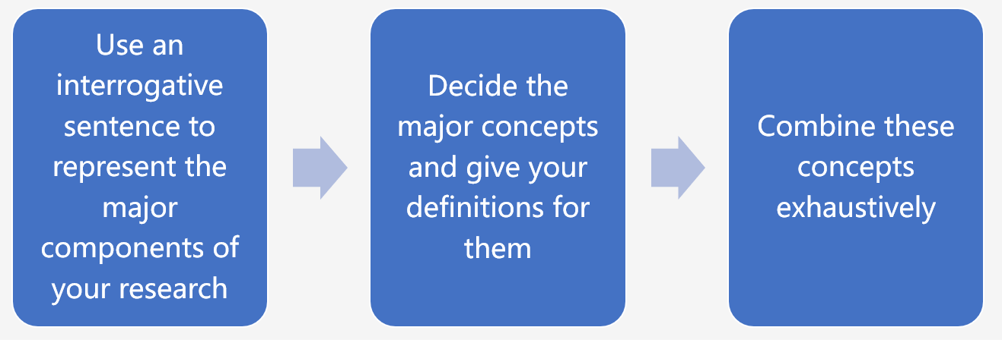
Depict the structure of the question
Notes:
The background investigation for scientific questions started with the depiction of background structure. The essence of this step is to provide a visual framework which benefits the task division for the next two steps.

Slide 27
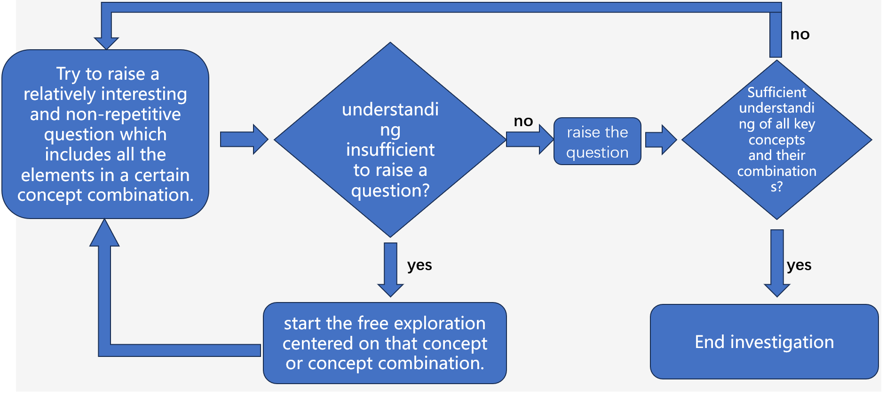
General background investigation
Notes:
Next, the essence of general background investigation is to rapidly form vivid, concrete understanding of the key concepts of the question in a painless, curiosity-driven way. This on one hand can help cultivate genuine motivation for research; on the other hand, this can also provide the general knowledge necessary for smooth exploration in the more complex academic background investigation stage.

Slide 28
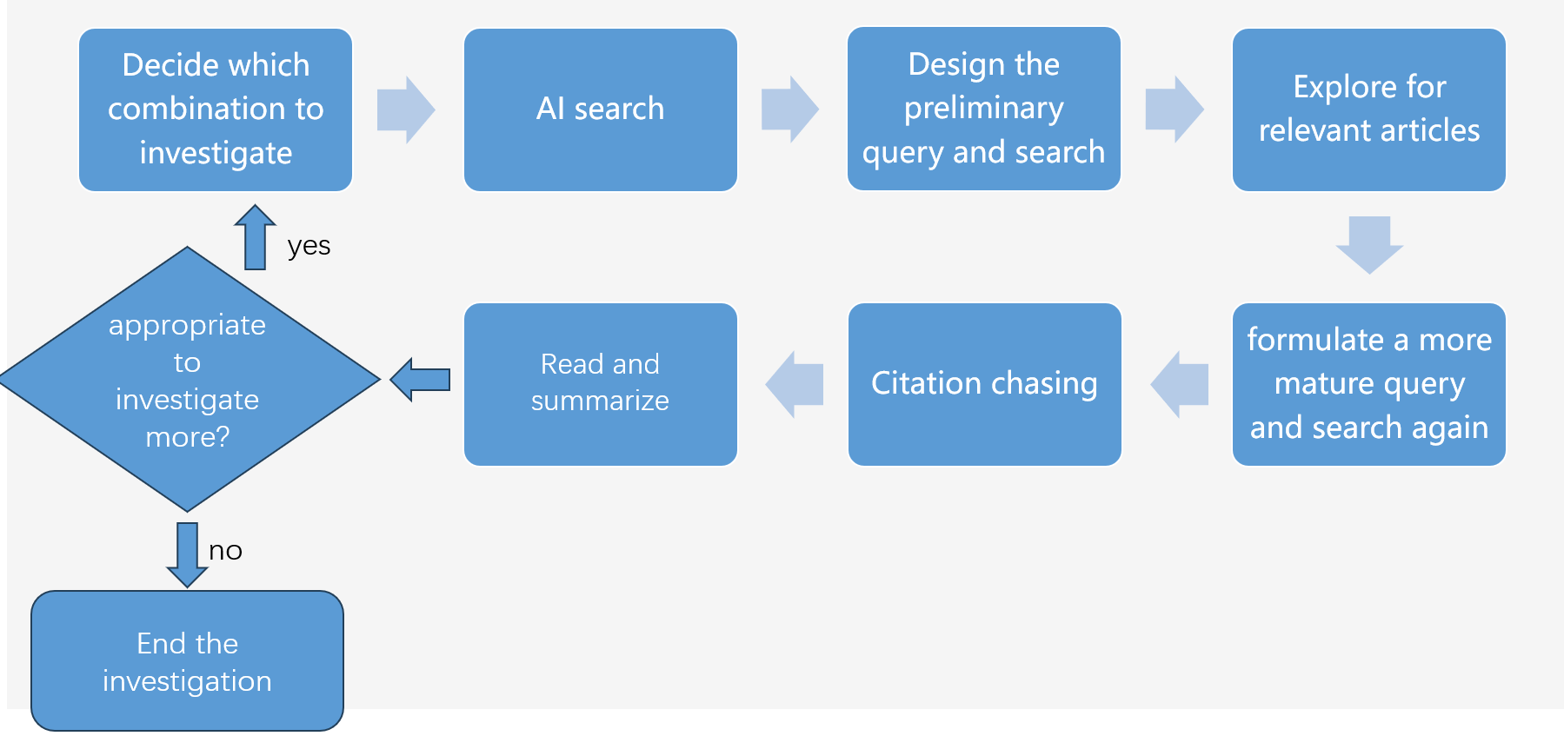
Academic background investigation
Notes:
Academic background investigation is the most critical step. Its essence is to explore academic knowledge relevant to the research question systematically and exhaustively so as to define the question as accurately as possible and strive to find the optimal solution to the question.

Slide 29
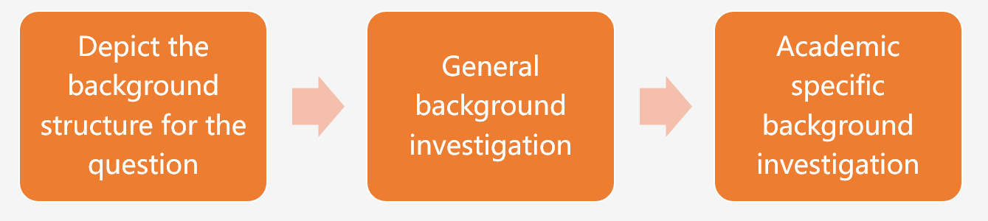
yes
need to adjust the question?
need to adjust the question?
yes
no
no
In the process of science research, the background investigation guided by concept combinations is suitable for the question-refining stage and the systematic update of literature review at latter stage.
Apart from scientific questions, the aforementioned technique may be applied to any questions that are interesting enough and worthy of your serious attention.
Notes:
During the last two steps, it’s possible to feel the need to adjust the question due to all kinds of factors in any moment. If that should happen, you need to update the background structure according to the new question and then continue to the next two steps.
In the process of science research, the background investigation guided by concept combinations is suitable for the question-refining stage and the systematic update of literature review at latter stage. In other situations, you can leave the concept combination framework behind and flexibly investigate background based on specific needs.
Apart from scientific questions, the aforementioned technique may be applied to any questions that are interesting enough and worthy of your serious attention.
And this is the end of this video. Considering it’s actually quite laborious to type concept combinations manually, I cooperate with llm and wrote a python script which can generate concept combinations automatically. I’ve put it in Google colab and its link is below the video.

